Slide 1

DATA 410 – Assignment 7 Final Presentation
Flavio Akira Tikaishi Oliveira

Slide 2
1 – Business Understanding –High Level
Notes:
For the High Level Business Understanding focus on the Case Study supplied.

Slide 3
Case Study
COVID-19 pandemic in Alberta:
Involve the analyses of the virus dissemination and recent results from the vaccine.

Slide 4
Introduction
Covid 19 - Experts say SARS-CoV-2 originated in bats. SARS-CoV-2 made the jump to humans at one of Wuhan’s open-air “wet markets.” They’re where customers buy fresh meat and fish, including animals that are killed on the spot.
Studies confirmed first case of Covid 19 in Alberta was a woman in her 50s who believe contracted aboard the Grand Princess cruise ship out of California. She returned home to the Calgary zone on February 21, 2020.

Slide 5
5W 1H Analysis 1 – Who
# | Question | Answer
Q1.1 | Who is involved? | Everyone who is infected. Society, economic…
Q1.2 | Who is affected? | Principally the risk group and who is extremely exposed to the virus.
Q1.3 | Who will benefit? | N/A
Q1.4 | Who will be harmed? | When the virus started, we didn’t have any immediate solution as Vaccine. Then temporally solution as a lockdown or social distance. Then it harmed the health and the economy.
Notes:
The questions on this slide are sourced from this article:
https://premium.wpmudev.org/blog/a-simple-sure-fire-way-to-create-great-content-the-5-w-the-h/
Who is involved?
Who is affected?
Who will benefit?
Who will be harmed?

Slide 6
5W 1H Analysis 2 – What
# | Question | Answer
Q2.1 | What is your topic narrowed down in a simple phrase/sentence? | This is the pandemic of the millennium.
Q2.2 | What does your topic involve? (i.e. What are the different parts to it?) | This topic involves the analyses of the virus dissemination and recent results from the vaccine in the population.
Q2.3 | What is it similar to / different from? | It is hard in history to found any other pandemic that causes so many effects on the society or economy. A unique case that is similar was the Spanish influenza pandemic (1918 - It is estimated that approximately 20 to 40 percent of the worldwide population became ill and that over 50 million people died).
Q2.4 | What might be affected/changed by your topic? | Due of the effect and cause are so in “real time”. The actual actions could not be the most efficient across the time.
Notes:
The questions on this slide are sourced from this article:
https://premium.wpmudev.org/blog/a-simple-sure-fire-way-to-create-great-content-the-5-w-the-h/
What is your topic narrowed down in a simple phrase/sentence?
What does your topic involve? (i.e. What are the different parts to it?)
What is it similar to / different from?
What might be affected/changed by your topic?

Slide 7
5W 1H Analysis 3 –When
# | Question | Answer
Q3.1 | When does this take place? When did this take place? When will it take place? When should this take place? | The first case was identified in Wuhan, China, in December 2019.
Q3.2 | Does when this takes place affect the topic? | The first identified case of Covid -19 was in December 2019 in Wuhan, China.
Notes:
The questions on this slide are sourced from this article:
https://premium.wpmudev.org/blog/a-simple-sure-fire-way-to-create-great-content-the-5-w-the-h/
When does this take place? When did this take place? When will it take place? When should this take place?
Does when this takes place affect the topic?

Slide 8
5W 1H Analysis 4 – Where
# | Question | Answer
Q4.1 | Where does this take place? (Where did it …. Where will it … Where should it ….?) | The first case was identified in Wuhan China. The first Canadian case of the novel coronavirus was reported by Health Canada on Jan. 25, 2020, in a Toronto man who had recently travelled to Wuhan, China. First case of Covid 19 in Alberta was a woman in her 50s who believe contracted aboard the Grand Princess cruise ship out of California. She returned home to the Calgary zone on February 21, 2020.
Q4.2 | Does it matter where it takes place? Is it affected by location? | At the beginner, Yes. Because they tried to control the virus by isolating contaminated people. After the spread of the virus, it doesn't make a difference.
Notes:
The questions on this slide are sourced from this article:
https://premium.wpmudev.org/blog/a-simple-sure-fire-way-to-create-great-content-the-5-w-the-h/
Where does this take place? (Where did it …. Where will it … Where should it ….?)
Does it matter where it takes place? Is it affected by location?

Slide 9
5W 1H Analysis 5 – Why
# | Question | Answer
Q5.1 | Why is this topic important? Why does it matter? | Understanding what we did wrong, makes us learn how we should act if/when we have future pandemics
Q5.2 | Why do certain things happen? (What are some causes and effects within the topic?) | Mutation of the virus and feed on exotic animals could be a possible explanation of why it is happening.
Notes:
The questions on this slide are sourced from this article:
https://premium.wpmudev.org/blog/a-simple-sure-fire-way-to-create-great-content-the-5-w-the-h/
Why is this topic important? Why does it matter?
Why do certain things happen? (What are some causes and effects within the topic?)

Slide 10
5W 1H Analysis 6 – How
# | Question | Answer
Q6.1 | How does this topic work? How does it function? How does it do what it does? | Understand how this virus works. Can help us to be more prepared for any future world pandemic.
Q6.2 | How did it come to be? | Experts say SARS-CoV-2 originated in bats. That’s also how the coronaviruses behind Middle East respiratory syndrome (MERS) and severe acute respiratory syndrome (SARS) got started.
Q6.3 | How are those involved affected? | people are involved from illness, social distance, lockdown, isolation, even psychological and economic issues
Notes:
The questions on this slide are sourced from this article:
https://premium.wpmudev.org/blog/a-simple-sure-fire-way-to-create-great-content-the-5-w-the-h/
How does this topic work? How does it function? How does it do what it does?
How did it come to be?
How are those involved affected?

Slide 11
2 – Data Understanding – High Level

Slide 12

Data Modeling – Conceptual Model
Risk group
Lung disease
Heart disease
High blood pressure
Diabetes
kidney disease
> 60 years
Vaccine / Cure
Pfizer/Biontech
Oxford/ Astrazenica
Moderna
Sputnik V
Sinopharm
Sinovac
Janssen
EpiVacCorona
Covaxin(Bharat Biotech)
Symptoms
fever
dry cough
Tiredness
aches and pains
sore throat
diarrhea
conjunctivitis
headache
loss of taste or smell
difficulty breathing or shortness of breath
chest pain or pressure
loss of speech or movement
Temporary solutions
Isolation
Quarantine
Mask
Alcohol gel
Mutation/Variant
highly contagious
Resistance
Other symptoms
New problem
Variant Virus
Logistic
Supplies
Material

Slide 13
Data Dictionary
No | Topic | Definition
1 | ARDS | Acute respiratory distress syndrome.
2 | COPD | chronic obstructive pulmonary disease
3 | Risk Group | Lung disease, Heart disease, High blood pressure, Diabetes, kidney disease > 60 years
4 | COVID 19/ Coronavirus | Coronavirus disease 2019 (COVID-19) is a contagious disease caused by severe acute respiratory syndrome coronavirus 2 (SARS-CoV-2)
5 | MERS | Middle East respiratory syndrome
6 | Alberta | Alberta is a province in Western Canada.
7 | Vaccine | Substance used to stimulate the production of antibodies and provide immunity against one or several diseases.
8 | Mutation | When a virus replicates or makes copies of itself, it sometimes changes a little bit, which is normal for a virus. These changes are called “mutations”.
9 | Variant | A virus with one or more new mutations is referred to as a “variant” of the original virus.
10 | Isolation | keeps someone who is sick or tested positive for COVID-19 without symptoms away from others, even in their own home
11 | Quarantine | keeps someone who was in close contact with someone who has COVID-19 away from others.

Slide 14
1 (Revisited) – Business Understanding – Low Level

Slide 15
Business Questions
Question 1) First day December 15, 2020. Can we see any change in cases/ deaths by Covid 19 in Alberta since the beginning of the vaccine campaign?
Question 2) How was the dissemination and virus propagation in Canada considering international and domestic cases?

Slide 16
2 (Revisited) – Data Understanding – Low Level

Slide 17
Data Set(s)
http://data.opencovid.ca/archive/index.html#archive/can/
https://www.alberta.ca/stats/covid-19-alberta-statistics.htm#data-export
http://data.opencovid.ca/archive/index.html#archive/can/cases-by-exposure-time-series/

Slide 18
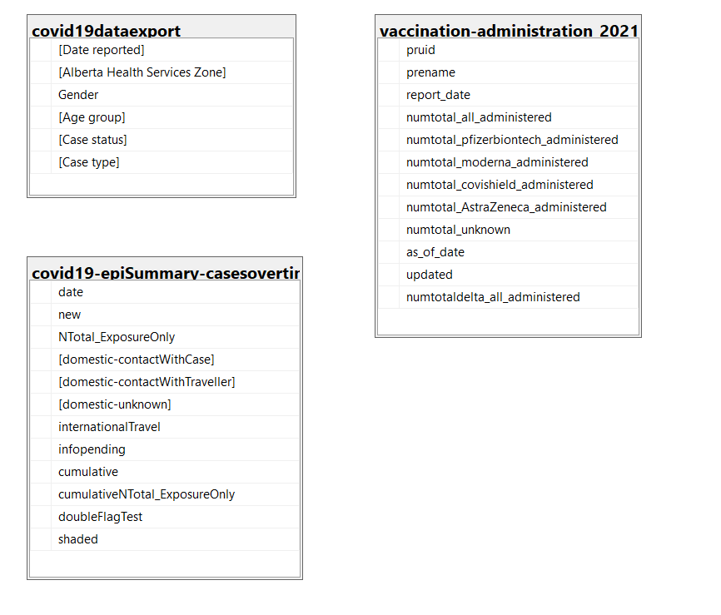
Database Diagram – Tables and Columns
Notes:
Load the Data Set into SQL Server.
Use the SQL Server Management Studio (SSMS) Diagramming tool to produce the Database Diagram.

Slide 19
3 – Data Preparation

Slide 20
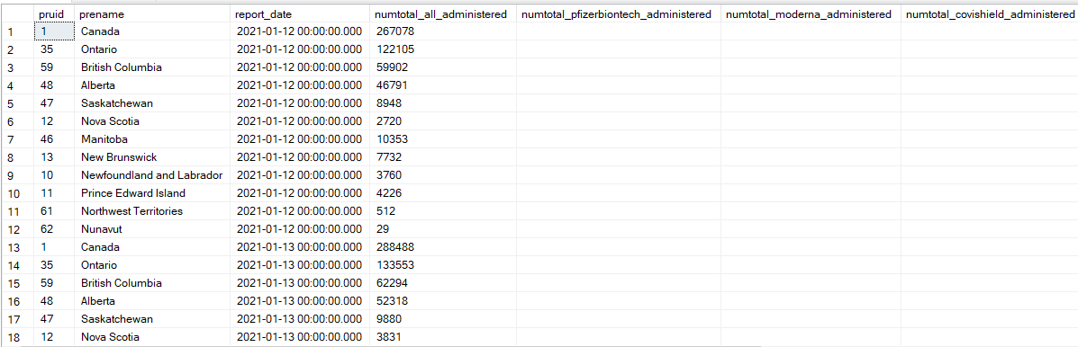
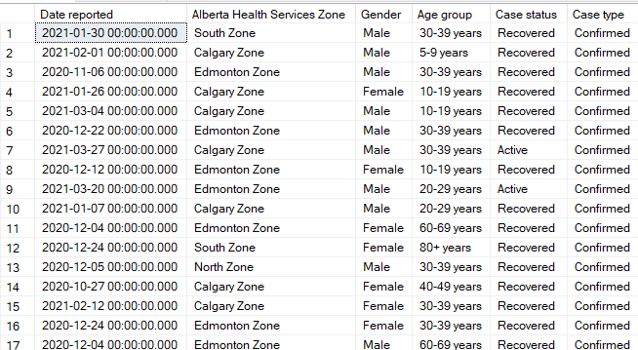
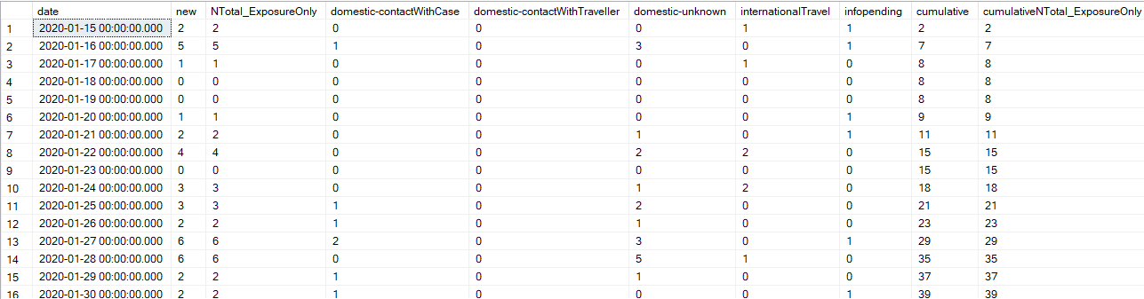
Data Preparation – Data cleansing
Different types of documents(.html, .json, .csv, .png, .txt)
Removed several blank or null columns.
Rename columns.
Notes:
Document any data cleansing that was required, any quality issues encountered with the data.

Slide 21
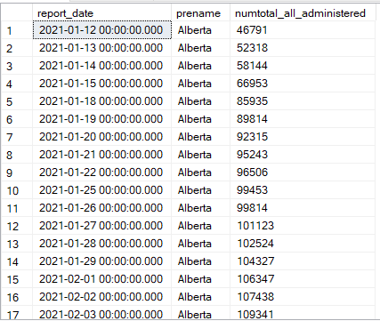
Data Preparation – SQL Query for Question 1 Part-1
CODE – Doses Administered
select report_date, prename, numtotal_all_administered
from [vaccination-administration_2021-03-30_22-04]
where prename = 'Alberta'
order by report_date
Notes:
Use the SQL Server Management Studio (SSMS) tool to produce the SQL Query.
In this slide provide the SQL Query in text format, not screen shot format.

Slide 22
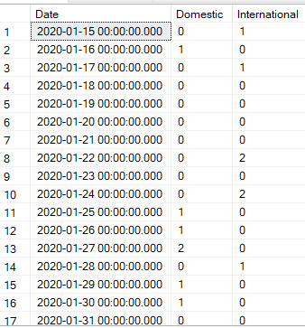
Data Preparation – SQL Query for Question 2
CODE – Domestic/ International Cases In Alberta
select date as Date, [domestic-contactWithCase] Domestic, internationalTravel International
from [covid19-epiSummary-casesovertime_2021-03-30_22-04]
order by date
Notes:
Use the SQL Server Management Studio (SSMS) tool to return the results of the SQL Query.
In this slide have a screen shot of the results.

Slide 23
4 – Modeling

Slide 24
TimeLine – Covid -19 Symptoms Develop
Day 3 to day 6
Start Hospital Admission
Day 14
Average recovery time for mild diseases
Day 14 to 56
Average time to death in most severe cases
Day -5
Exposed to Virus.
Day 0
Symptoms start
Day 9
5% Intensive Care treatment
Day 7
Severe cases, possible pneumonia or ARDS
Day 21 to 42
Average recovery time if hospital admission needed
https://patient.info/news-and-features/coronavirus-how-quickly-do-covid-19-symptoms-develop-and-how-long-do-they-last

Slide 25
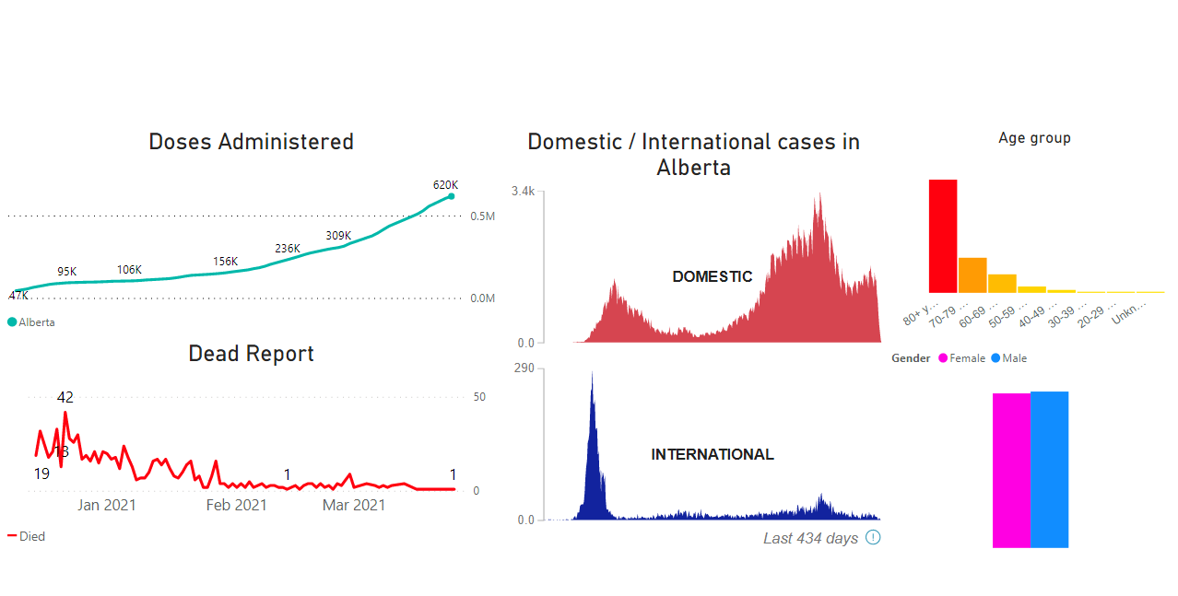
Visualization - Dashboard
The first wave starts in April 2020
The second wave starts November 2020- pike in December.
Notes:
Provide a screen shot of the visualization built in Power BI or Tableau.

Slide 26
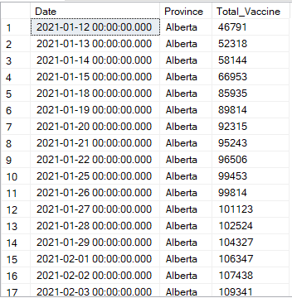
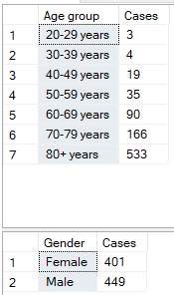
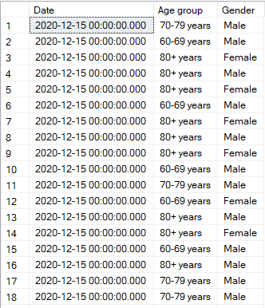
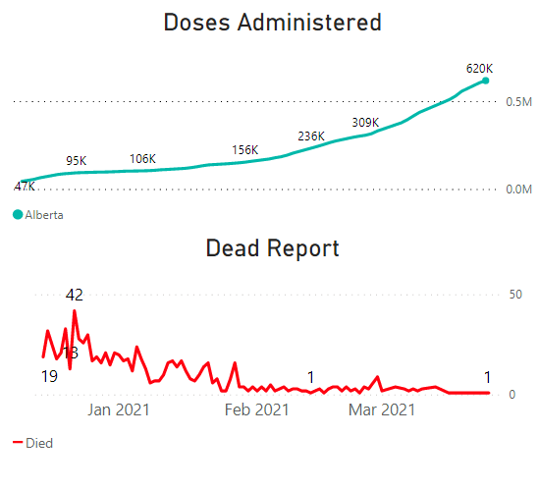
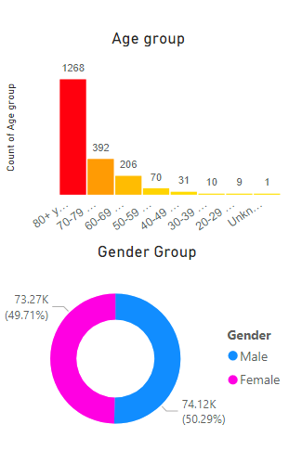
Visualization – Report Question - 1
Question 1) First day December 15, 2020. Can we see any change in cases/ deaths by Covid 19 in Alberta since the beginning of the vaccine campaign?
Doses Administered Data
Age Group Data
Gender Group Data
Dead Report Data
Notes:
Provide a screen shot of the visualization built in Power BI or Tableau.

Slide 27
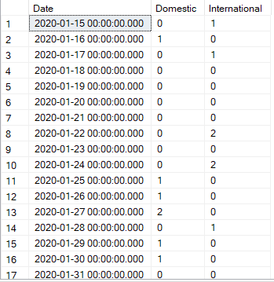
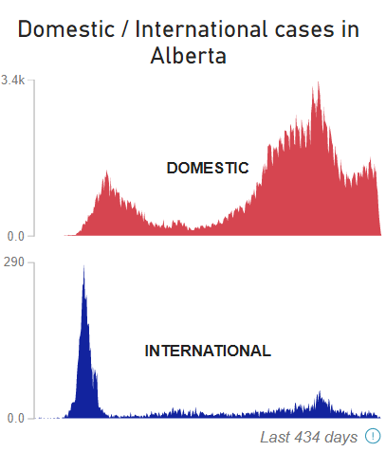
Visualization – Report Question - 2
Question 2) How was the dissemination and virus propagation in Canada considering international and domestic cases?
Domestic/ International Data
Notes:
Provide a screen shot of the visualization built in Power BI or Tableau.

Slide 28
5 – Evaluation

Slide 29
Conclusion – Answer to Question 1
Question 1) First day December 15, 2020. Can we see any change in cases/ deaths by Covid 19 in Alberta since the beginning of the vaccine campaign?
According to the analyses, we can confirm after a few months the cases reduce from a maximum of 42 dead cases in a day to 1 or 0 dead cases. It is pretty recently to have any final decision, but it is promissory.
Extra information: more than 90% of deaths were people older than>60 and gender is not a relevant fact. It is very equal to the cases of man or woman.
Notes:
The answer to the question from Slide 21 needs to be supported by the data visualized in the previous steps.

Slide 30
Conclusion – Answer to Question 2
Question 2)How was the dissemination and virus propagation in Canada considering international and domestic cases?
According to the data we can confirm the Virus started to spread in Alberta in March 2020 with international cases, after some of the government's decision of closing to other countries, we don’t have more international relevant cases.
Instead, the domestic cases present 2 big cases wave. First right after, the virus presents international cases ( around April 2020). The second wave present at the end of 2020 and that was the biggest wave present more than 3k cases in a day.
Isolation and quarantine were the principal mechanism that the government used to reduce the virus spread.
Notes:
The answer to the question from Slide 21 needs to be supported by the data visualized in the previous steps.

